Slide 1
Faculty Profile Maintenance
Web Development Project
Notes:
1

Slide 2

Team no:2
Team Members:
Kannan B (950018104017)
Arjun P (950018104007)
Mahesh Varun R (950018104025)
Vignesh S (950018104054)
Supervisor:
Dr. E. Golden Julie
Assistant Professor/CSE
Notes:
2

Slide 3
Introduction
Faculty Profile Maintenance used to view faculty members details who works in the institution
In the faculty Profile Maintenance the faculty can add, edit and delete the information's or details according to their wishes
Notes:
3

Slide 4
Objective
The purpose of the project is to build an application to reduce the manual work for managing faculty and employee information
Easy to filter the faculty details
It tracks all the details about the Faculty who works in the institution
Notes:
4

Slide 5


Problem Definition:
A Faculty Information Systems is a software designed webpage to
simplify the Collection , management , analysis and use of
information about the faculty members in an institution
1. Transparent tracking of faculty data
2. Improved fairness across the institution
3.Better experience for the user
4.Easier to find relevant information
Notes:
5

Slide 6


Tech Stack To Be Used:
Frontend
Backend
Notes:
6

Slide 7
Requirements :
Software Requirements:
Hardware Requirements :
Front end: HTML, CSS, Bootstrap, JavaScript.
Back-end: PHP, MySQL.
Operating System: Windows, Linux, Mac
Code Editor: VS Code.
Web Browser: Chrome, Firefox, etc.
Web Server: XAMPP
Processor: Intel core i3 or higher
Processor Speed: 1.8 GHz
RAM: 2GB
Storage: 1GB of free hard drive space.
System Type: 32-bit Operating System.
Notes:
7

Slide 8
System Analysis:
Existing System:
Initially colleges maintain the profiles of the faculty members to view the details and information about the faculty. Anyone can view the faculty profile
Notes:
8

Slide 9
Drawbacks
Difficulty in modifying the changes:
No admin Login:
In the existing system the faculty can only upload the completed details in a form of pdf. The faculty cannot change any details or information in the uploaded pdf regarding the changes.
There is no admin login in the existing system
There is no private data in the existing system.
In the existing system the private data cannot be viewed by neither the faculty nor the admin.
The private data contains confidential information about the work of the faculty
Generate Report:
No private data:
The admin in the existing system or website cannot generate the report, where the report contains the information about the private and public data of the faculty who is in the institution and the report can be filtered for a particular period of time
Notes:
9

Slide 10
System Analysis:
Proposed System:
This is a web-based application that allows to view the profile of
the faculty members who work in the institution
Notes:
10

Slide 11
Advantages
Modify the data:
In our new system after the faculty logged in, they can add their details and information. If there is any information regarding the changes in the information, they given they can modify or edit the information. If they want to remove the information, they can remove the information by the delete option given in our system.
Generation of pdf:
The pdf will be generated automatically for the information they gave earlier there will be no need for uploading any pdf. The pdf will be generated automatically by clicking the option generate pdf.
Notes:
11

Slide 12
Advantages
Admin Login:
A new page of admin login is created in the new system, where the old system does not contain any login for admin
Report Generation:
The report generation in the new system can only be accessed by the admin. The admin cam filter the details of the information about the faculty members data by the filter option given in the new system
Notes:
12

Slide 13
Advantages
Separation of data:
There is a separation of private and public data in the new system. The private data can only be accessed by the admin and the particular faculty who gave the information or details about them. The private data cannot be accessed by other people whereas the public data can be accessed by all the people.
Notes:
13

Slide 14
Literature Survey :
Anna University faculty Profile Chennai
(AUKDC Faculty Profile) :
Link : https://www.aukdc.edu.in/fis/facprofile_campus
This webpage came live in the mid of 2019
They used this webpage to show their profile of the faculty who works in the institution
The faculty members can edit their information and download their information as a form of pdf
Notes:
14

Slide 15
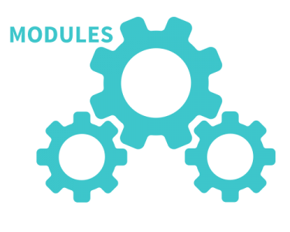

Modules :
The modules in the system are
AUTHENTICATION
FACULTY
PUBLIC DATA
PRIVATE DATA
ADMIN
VIEW PROFILE
Faculty Module :
Register as new user
Login using their id
Add information about them
Edit their information
Download their information as PDF
Notes:
15

Slide 16
Modules :
PUBLIC DATA:
The public data contain user’s basis info other information such as Programme Organized, the user can enter a list of data along with the month and year they have organized the programme. Public data is included in the profile PDF.
PRIVATE DATA:
The user can enter their private data such as on duty orders, Invigilation duties in the private information section. User’s public data is visible to all people, but private data is only visible to them and the Admin. Private data is not included in the profile PDF.
Notes:
16

Slide 17


Modules :
Admin Module
Add and delete the faculty profiles
Can manage the profile
Can filter the information about the Faculty within a
particular period of time
Notes:
17

Slide 18
Modules :
View Profile Module
In the Home page, any user or other people who visit the webpage can view the faculty Profile by Department. Only the public data is visible to them in a separate page. By clicking the Generate PDF button, the visitors can download the faculty’s public profile in a PDF format.
Notes:
18

Slide 19
SYSTEM DESIGN
Notes:
19

Slide 20
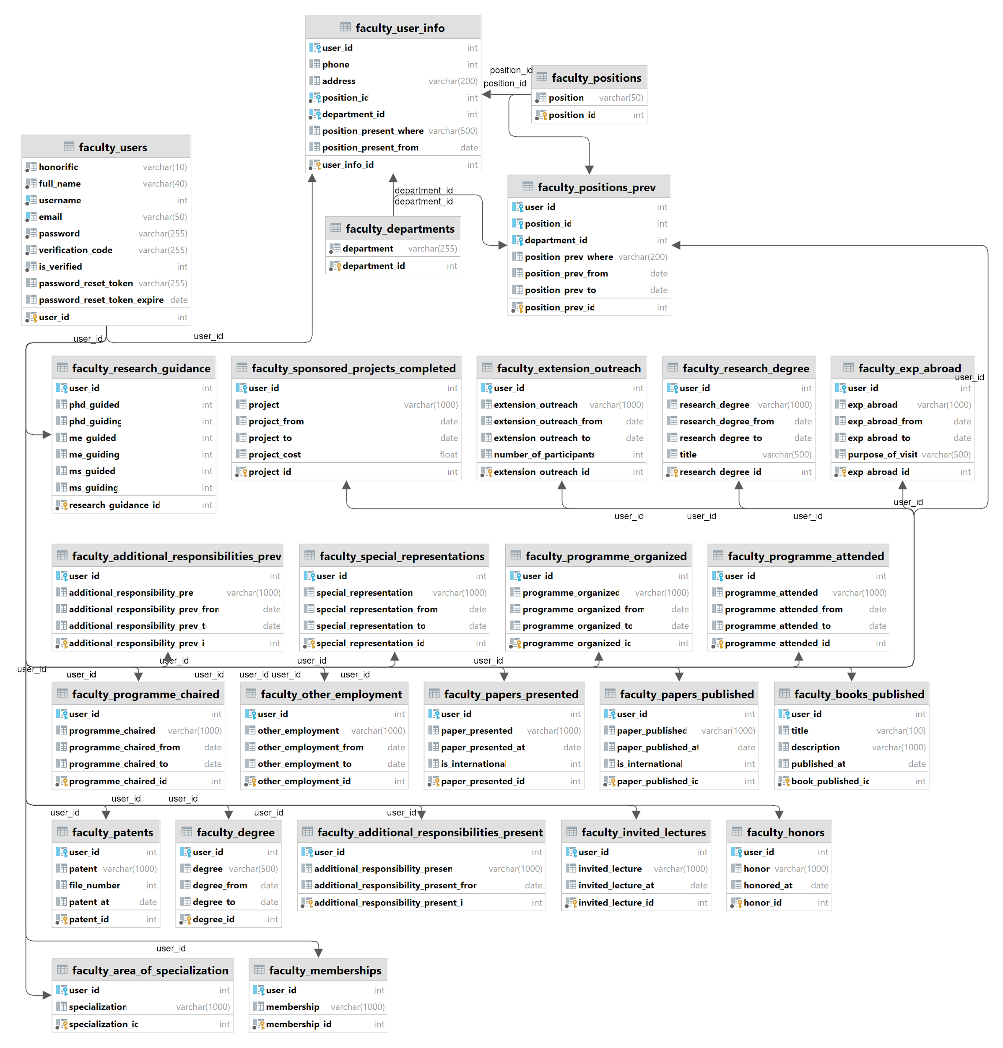
ER Diagram :
Notes:
20

Slide 21
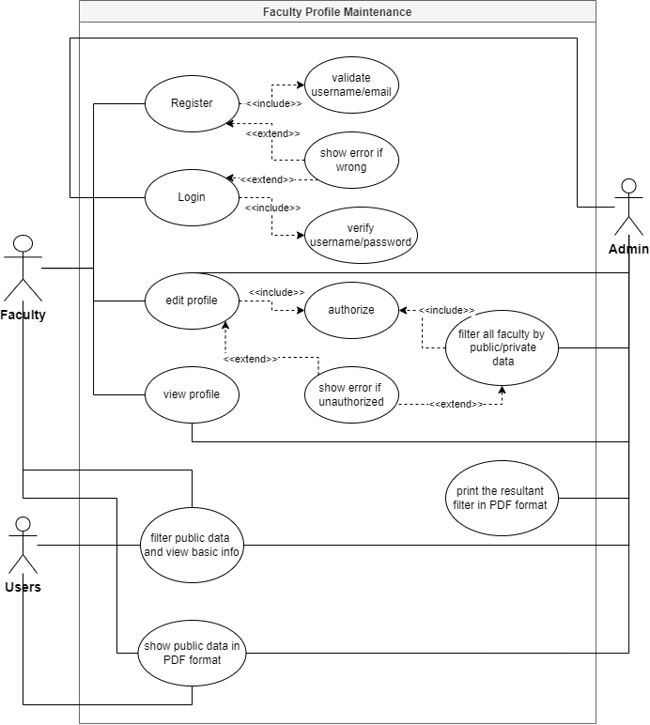
Use Case Diagram :
Notes:
21

Slide 22
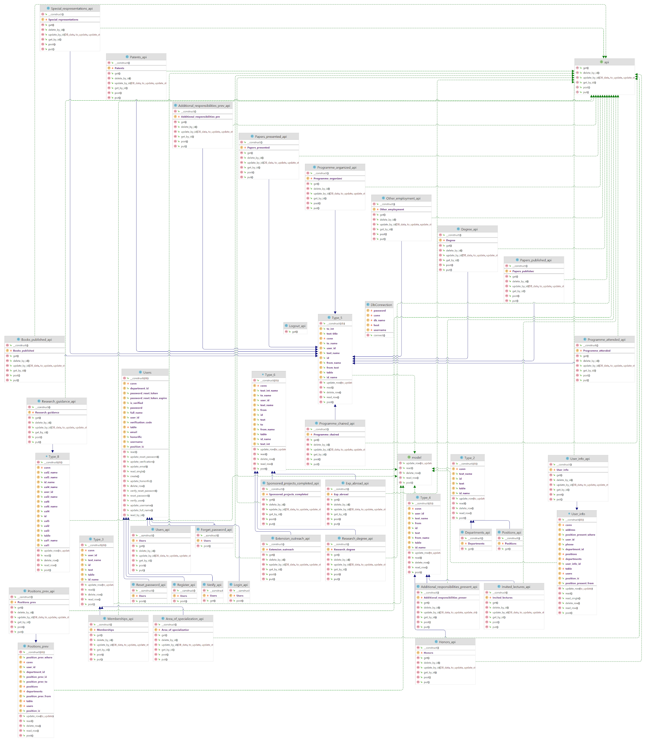
Class Diagram :

Slide 23
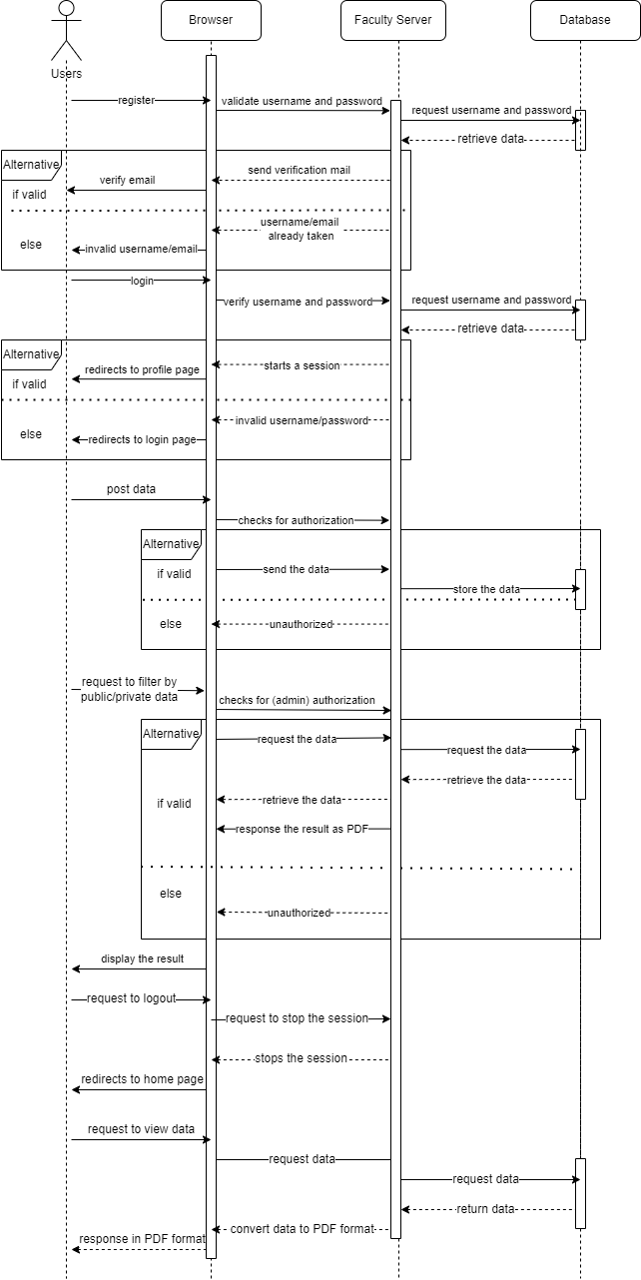
Sequence
Diagram :

Slide 24
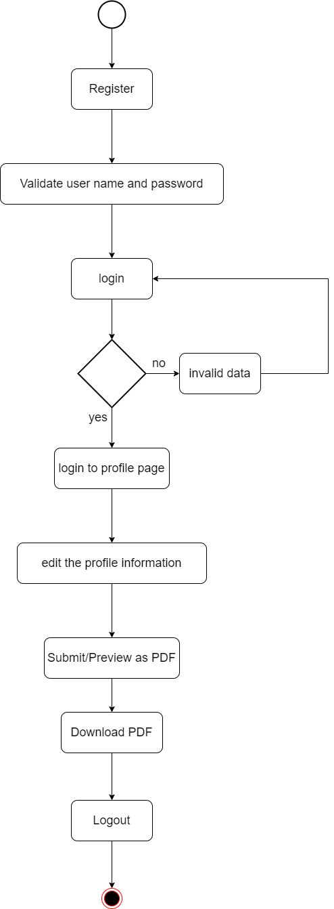
Activity
Diagram :

Slide 25
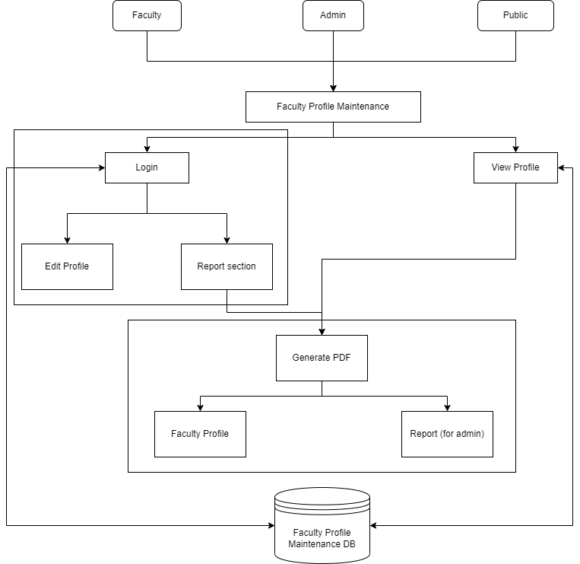
Architecture
Diagram :

Slide 26
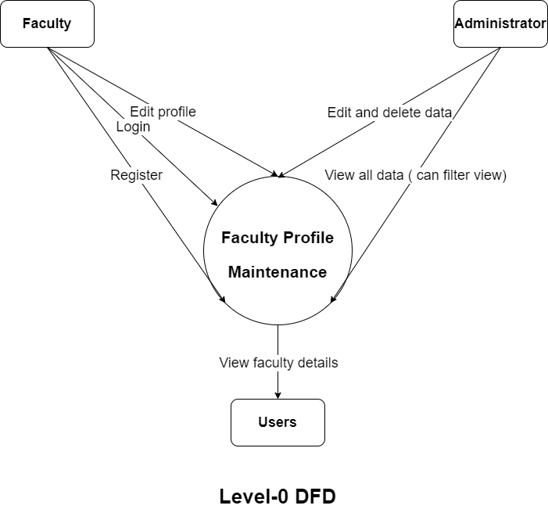
DFD Diagram :
Level 0 :

Slide 27
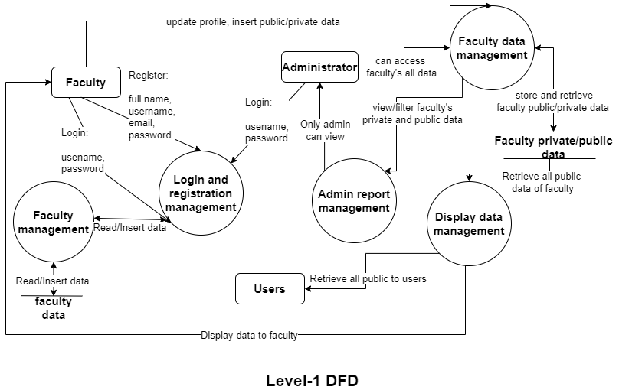
DFD Diagram :
Level 1 :

Slide 28
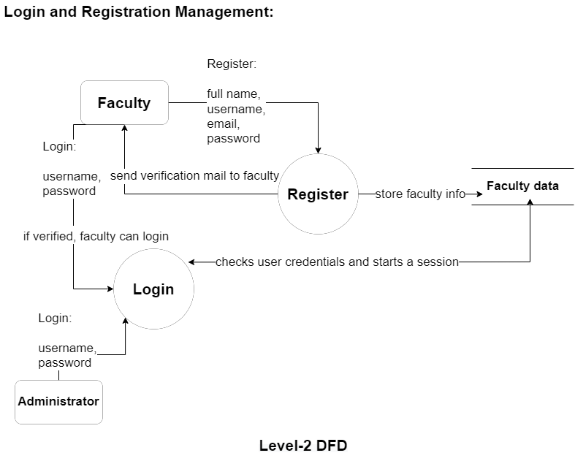
DFD Diagram :
Level 2.i :

Slide 29
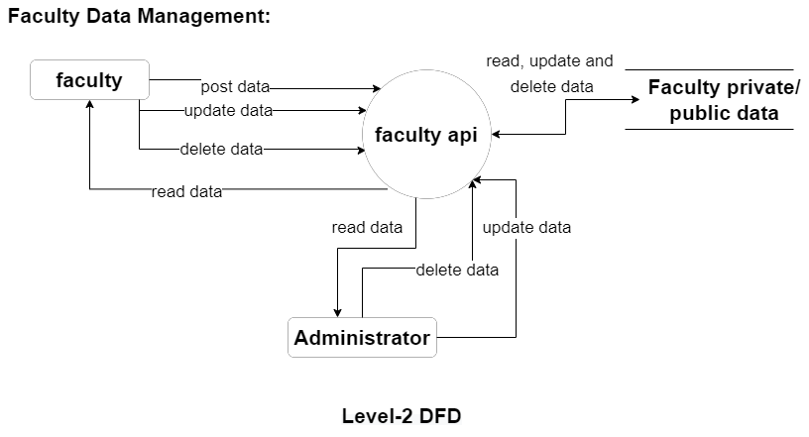
DFD Diagram :
Level 2.ii :

Slide 30
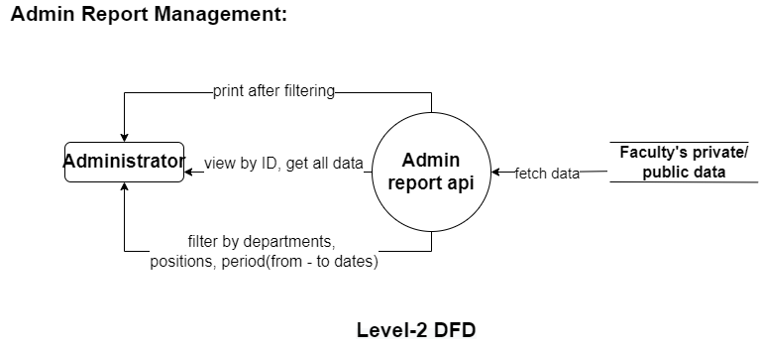
DFD Diagram :
Level 2.iii :

Slide 31
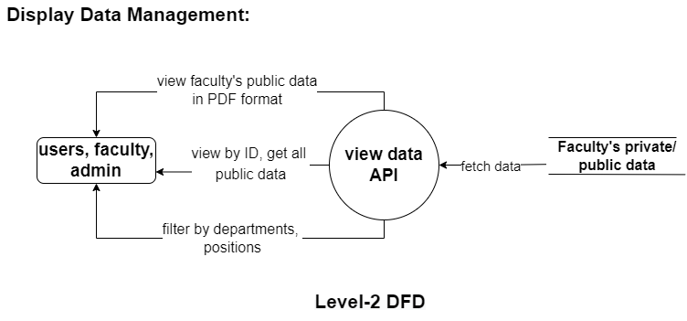
DFD Diagram :
Level 2.iv :

Slide 32
SYSTEM IMPLEMENTATION
Notes:
32

Slide 33
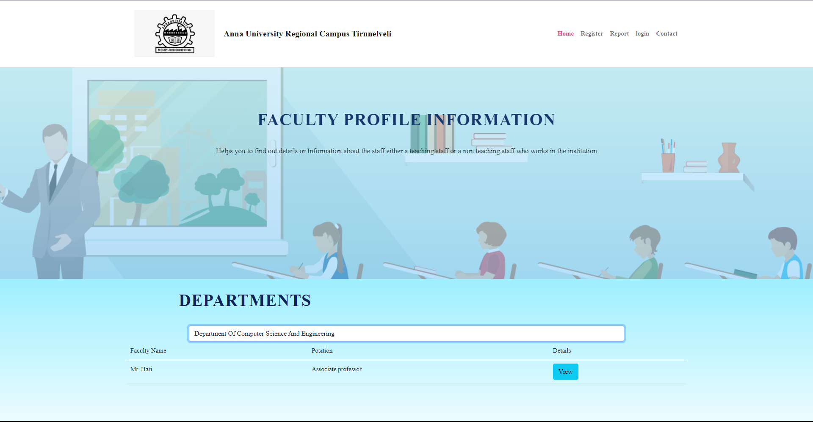
Screenshots :
Home Page
Notes:
33

Slide 34
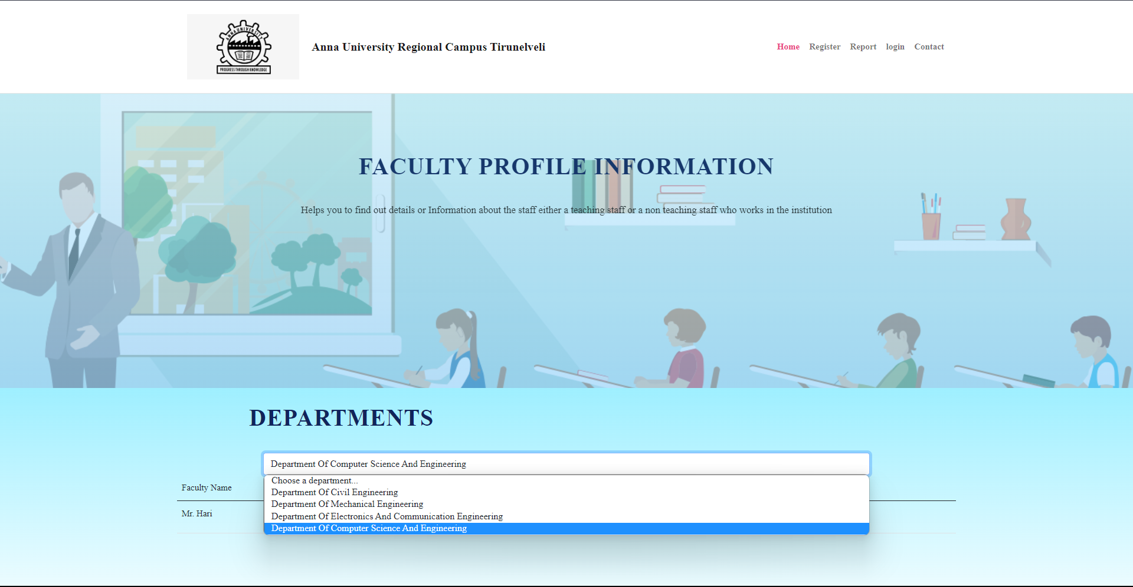
Screenshots :
Home Page
Notes:
34

Slide 35
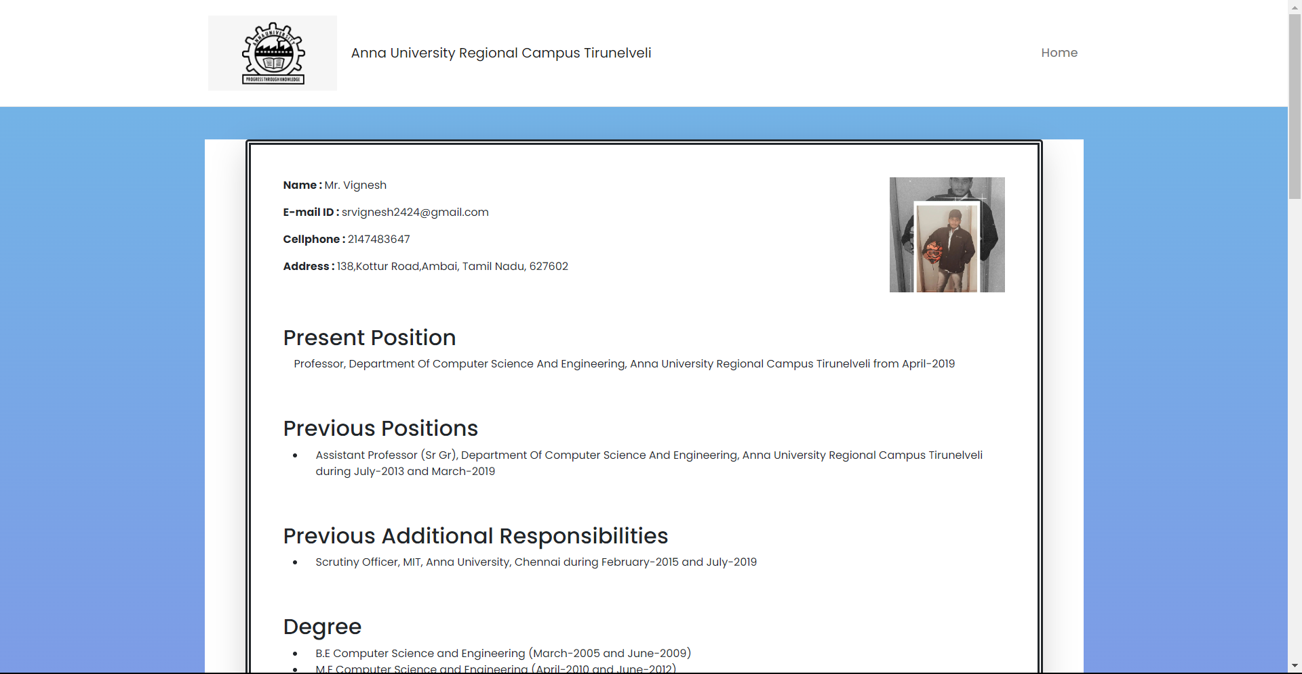
Screenshots :
Profile Page
Notes:
35

Slide 36
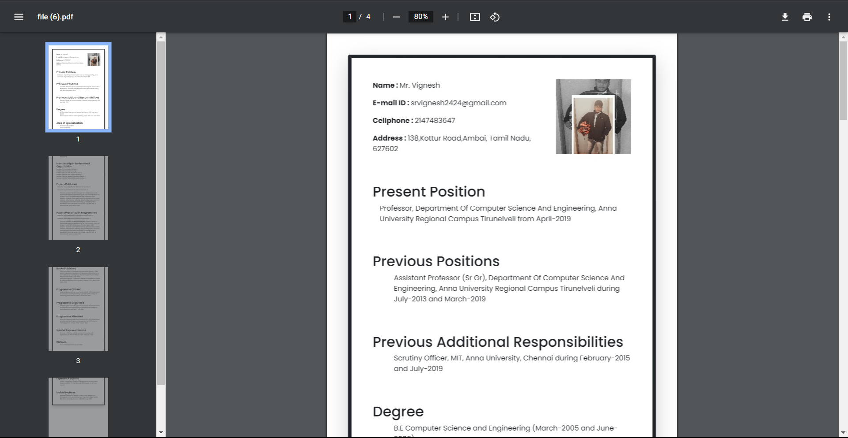
Screenshots :
Pdf Page
Notes:
36

Slide 37
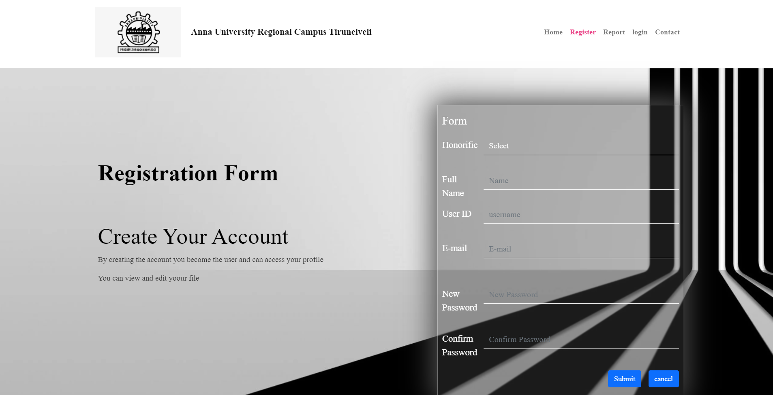
Screenshots :
Register Page
Notes:
37

Slide 38
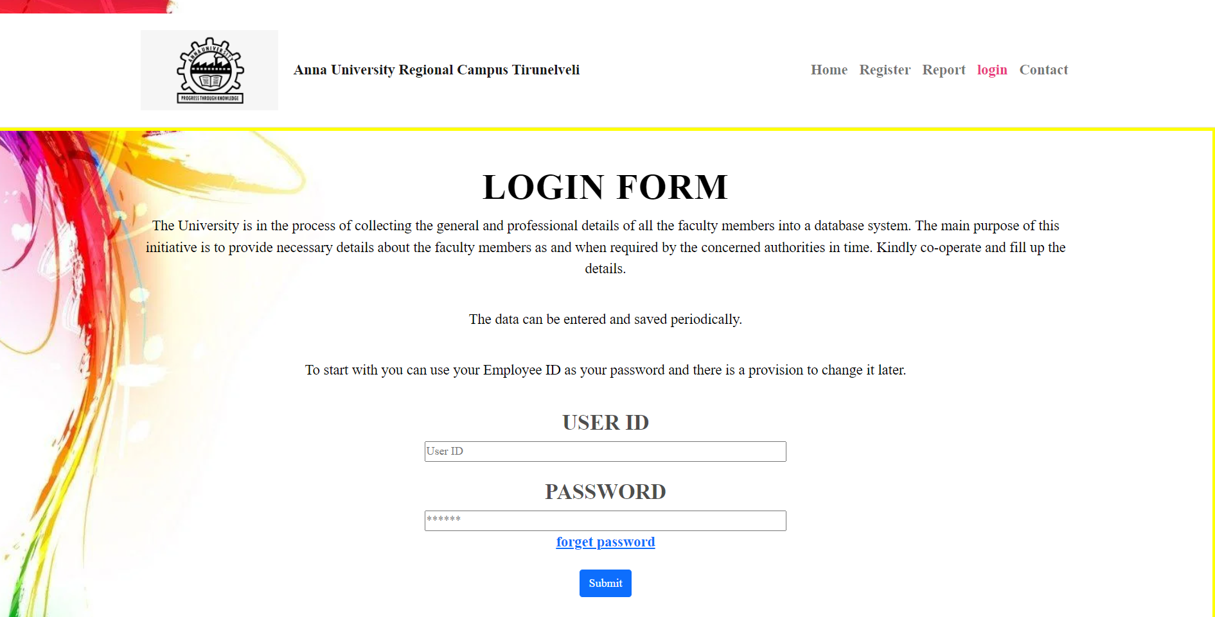
Screenshots :
Login Page
Notes:
38

Slide 39
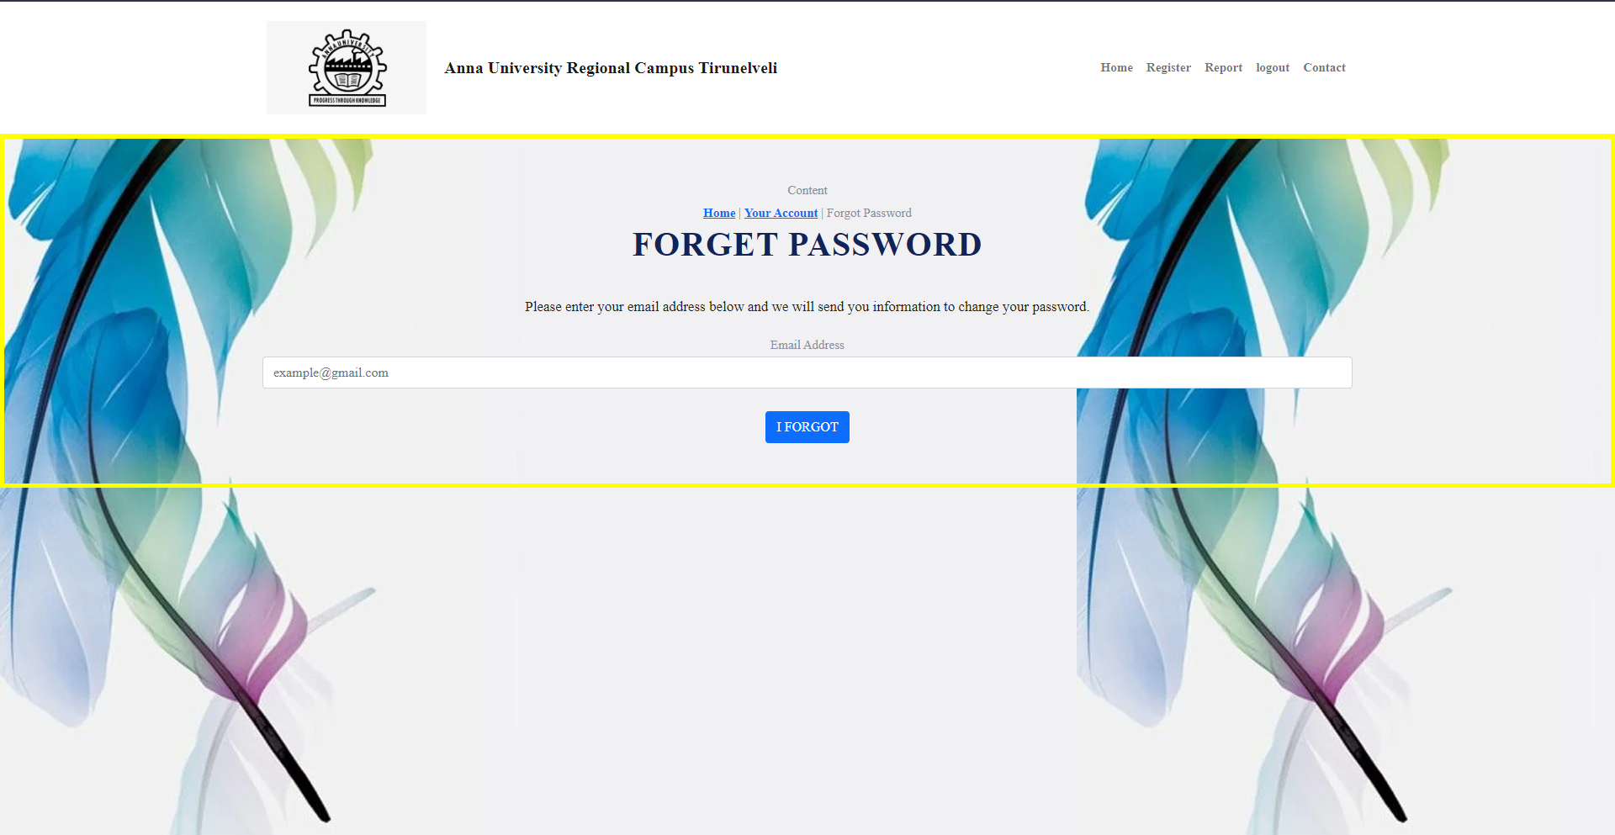
Screenshots :
Forgot Password page
Notes:
39

Slide 40
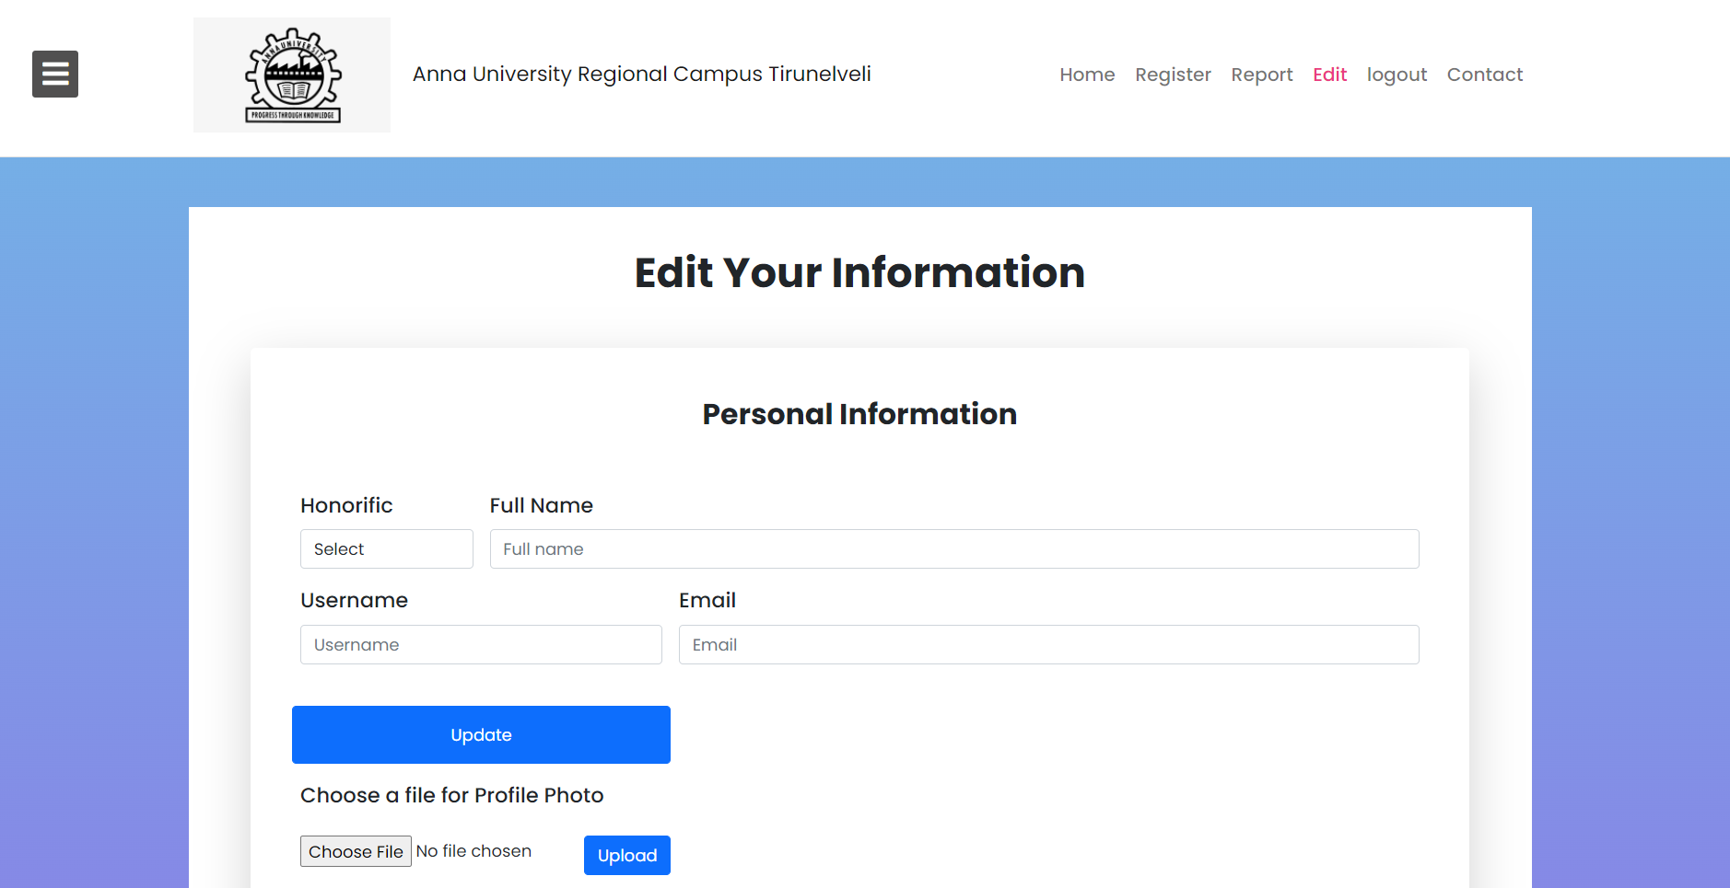
Screenshots :
Edit Page – Personal Info
Notes:
40

Slide 41
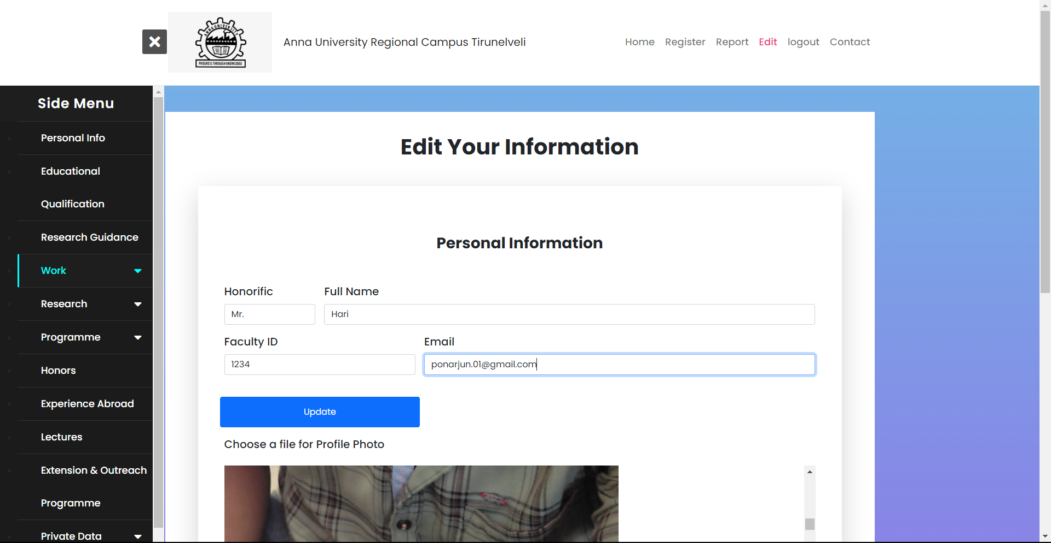
Screenshots :
Edit Page – Personal Info – Public Data
Notes:
41

Slide 42
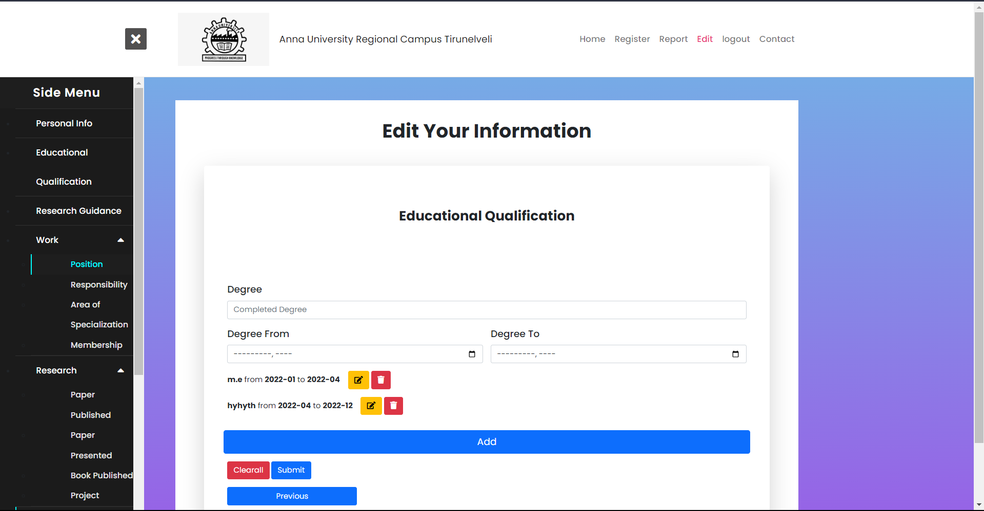
Screenshots :
Edit Page – Educational Qualification – Public Data
Notes:
42

Slide 43
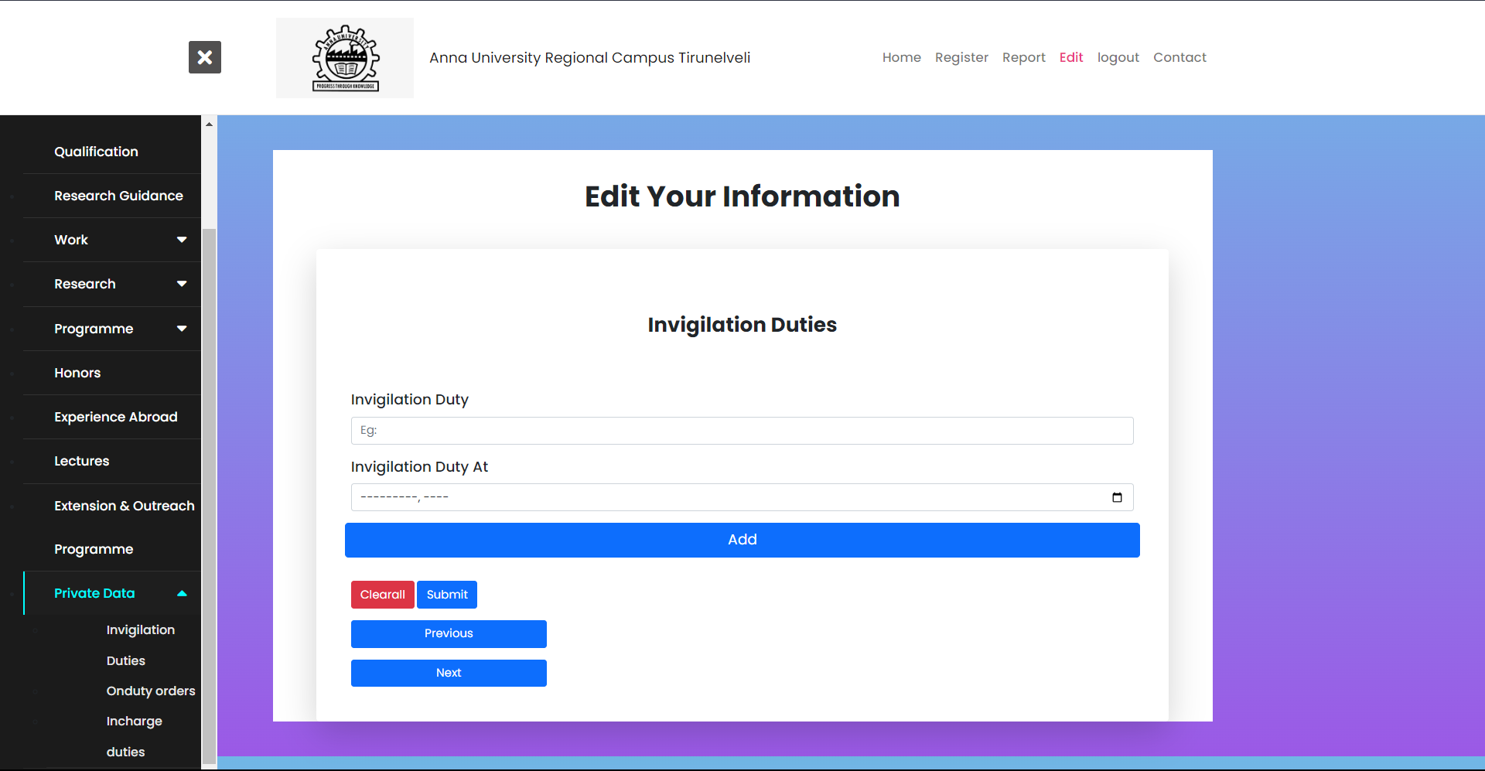
Screenshots :
Edit Page – Invigilation Duties – Private Data
Notes:
43

Slide 44
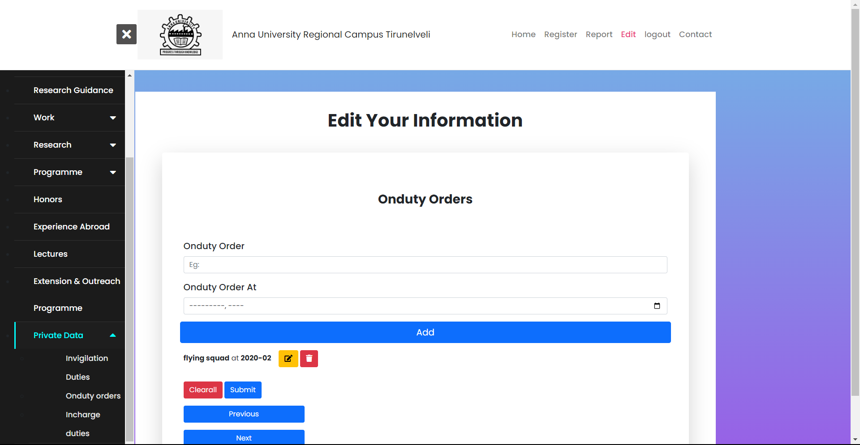
Screenshots :
Edit Page – On duty Orders – Private Data
Notes:
44

Slide 45
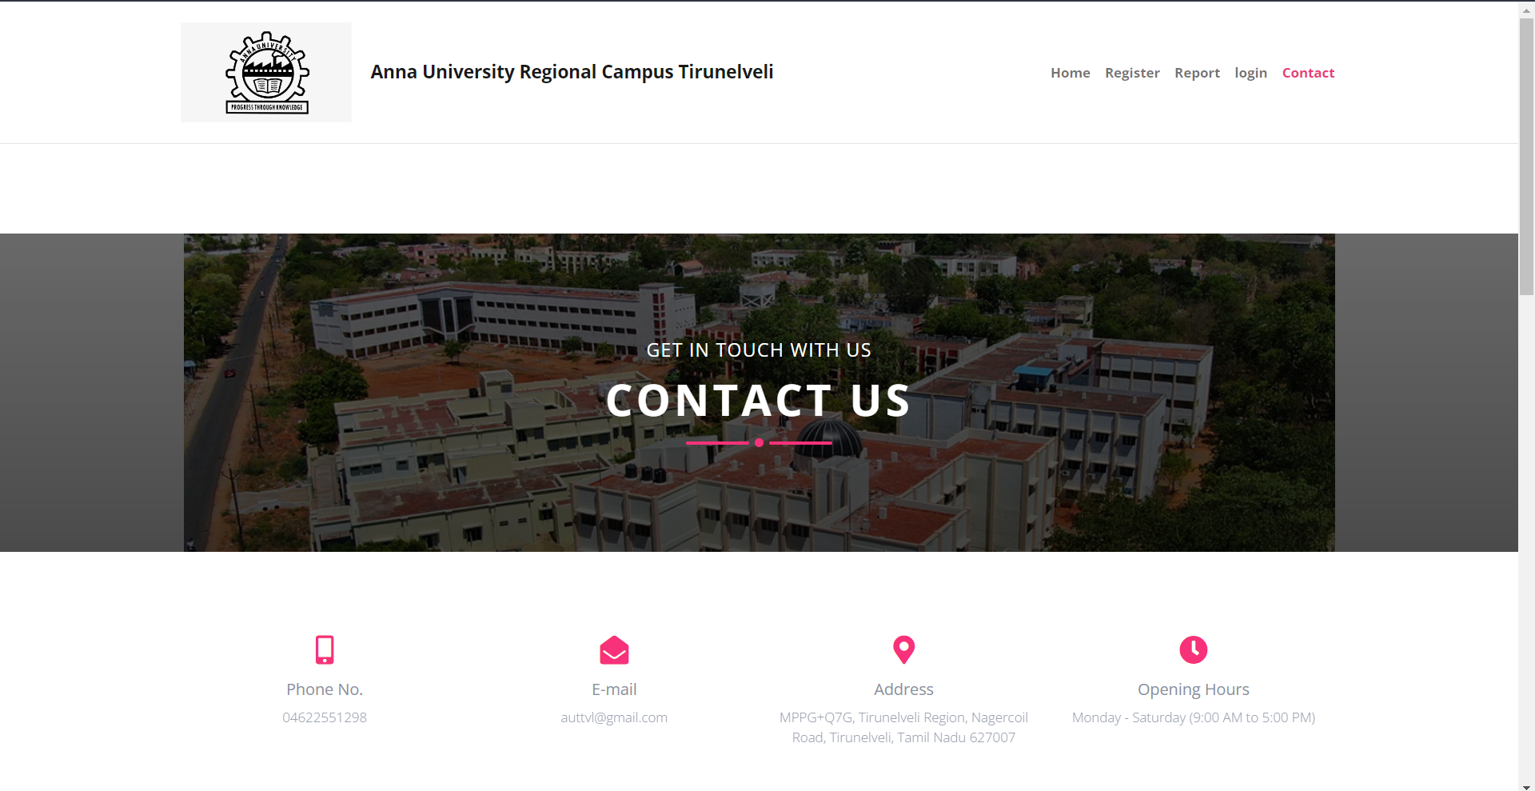
Screenshots :
Conatct Page
Notes:
45

Slide 46
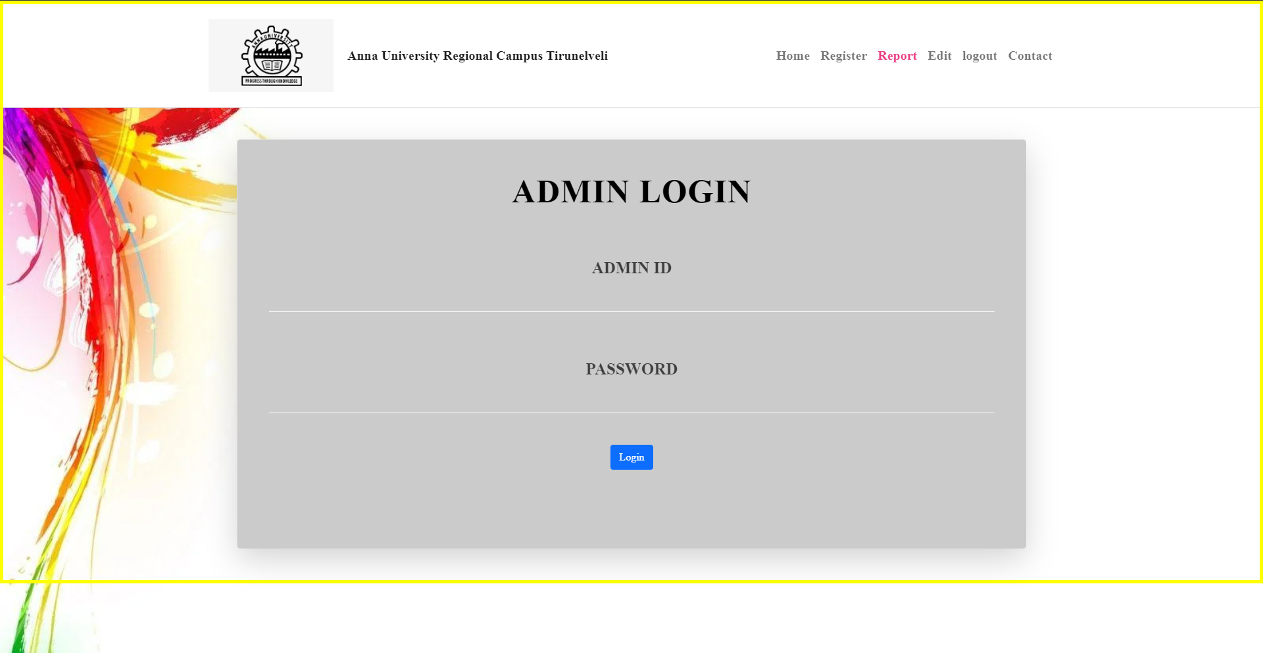
Screenshots :
Admin Login
Notes:
46

Slide 47
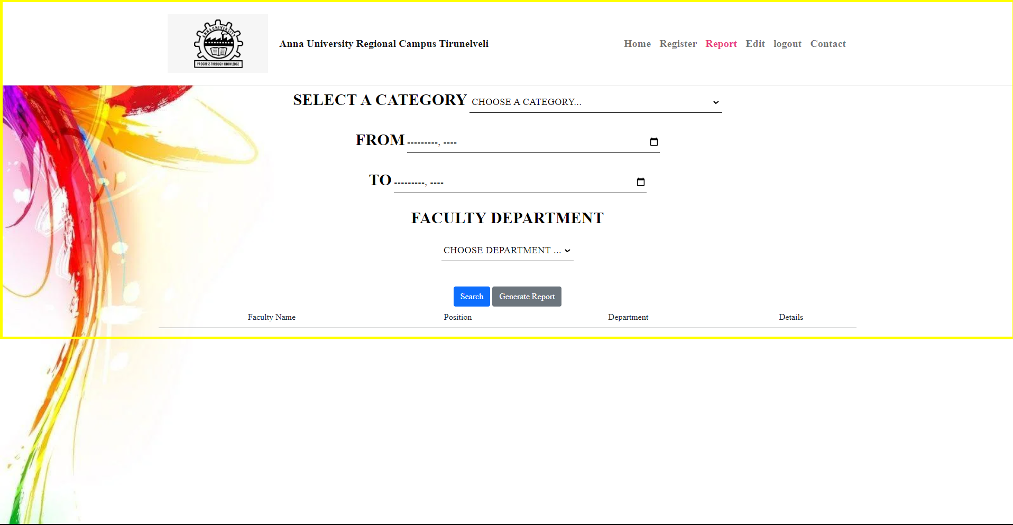
Screenshots :
Report Page
Notes:
47

Slide 48
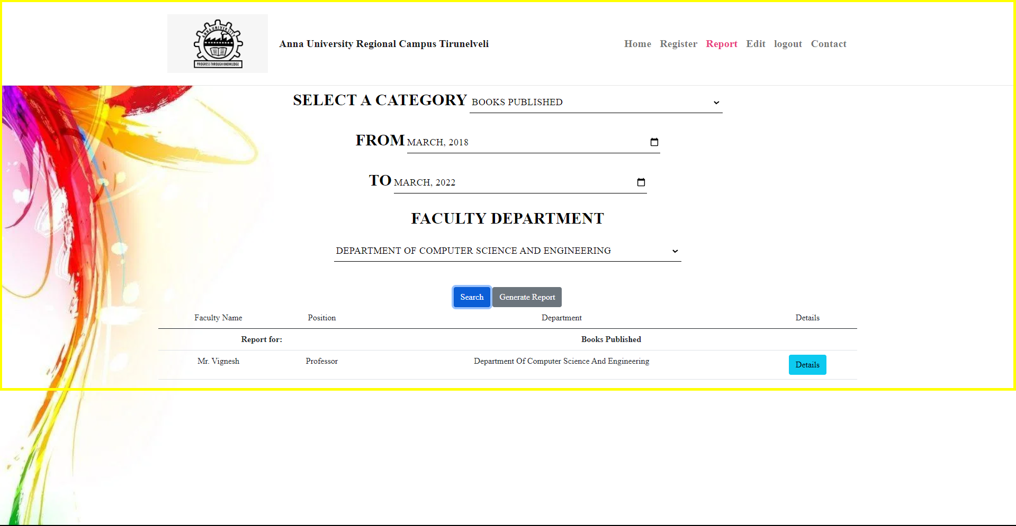
Screenshots :
Generating Report Page
Notes:
48

Slide 49
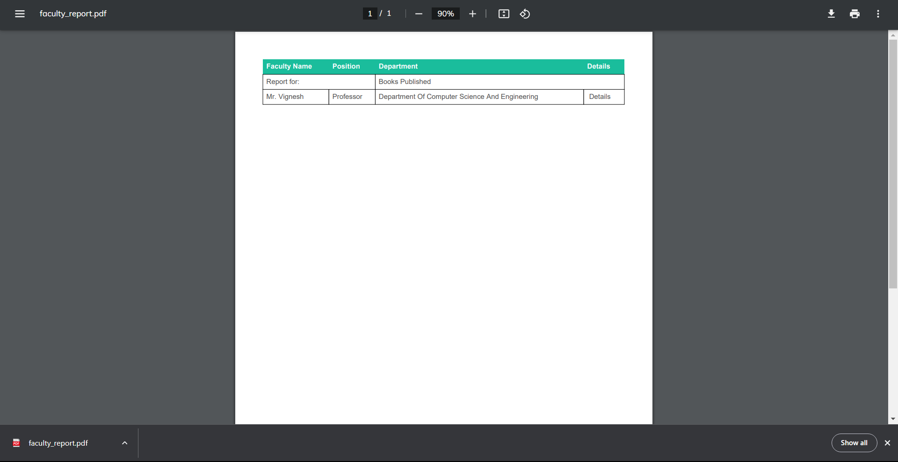
Screenshots :
Report Page
Notes:
49

Slide 50
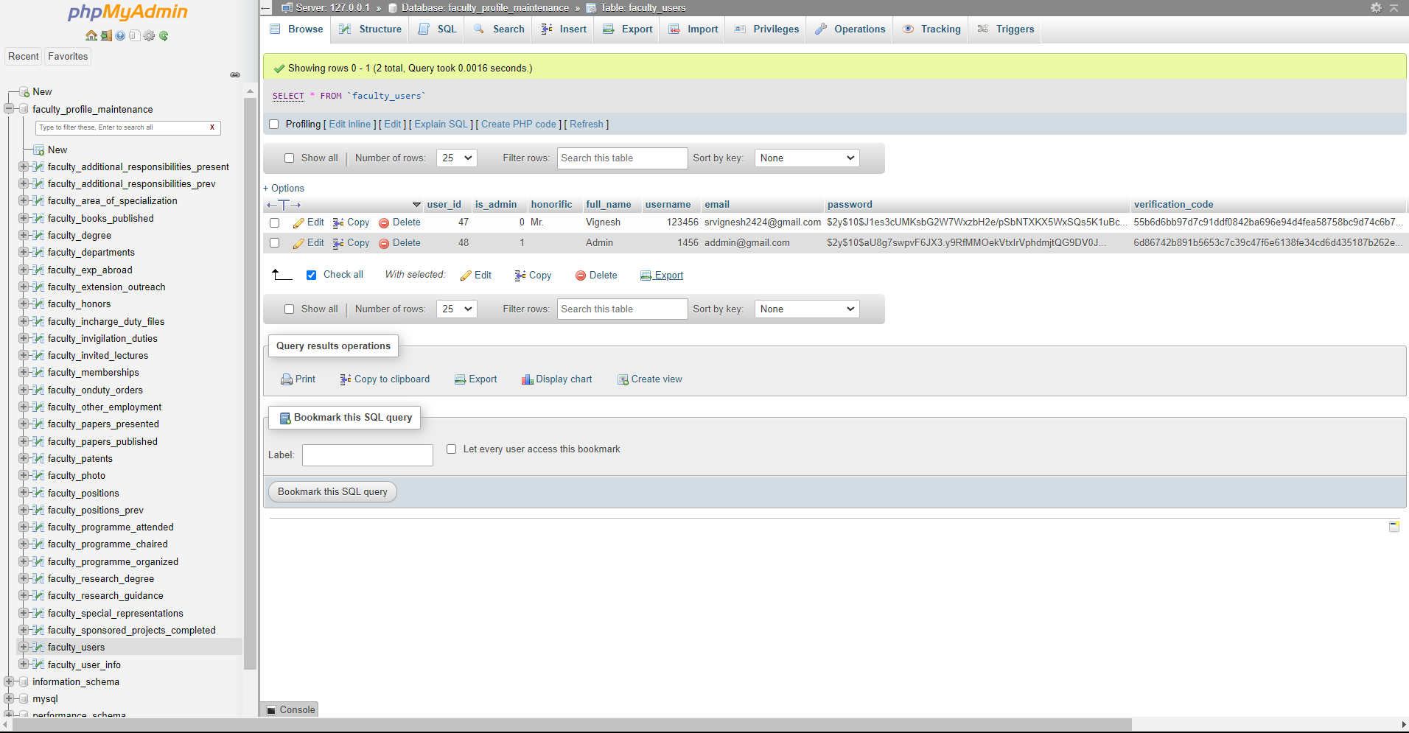
Screenshots :
Value stores in Database
Notes:
50

Slide 51


Conclusion:
Thus, the project Faculty Profile Maintenance is completed successfully with functional components and requirements satisfied. This application helps the staffs to view their information in the form of pdf and can download the pdf. This web-based application is designed using HTML and Bootstrap and is powered by backend technologies like PHP and MySQL with the help of XAMPP server.
Notes:
51

Slide 52
Future Enhancement:
The future enhancements that can be implemented in this project is to make this an independent module that can run on a production environment with a master database connected to it.
Notes:
52

Slide 53

Reference :
https://www.aukdc.edu.in/fis/facprofile_campus
https://www.educ.cam.ac.uk/people/acadstaff
https://aeroastro.mit.edu/faculty
https://www.w3schools.com
https://www.youtube.com/
https://developer.mozilla.org/en-US/docs/Web/HTML
https://developer.mozilla.org/en-US/docs/Web/CSS]
https://developer.mozilla.org/en-US/docs/Web/javascript]
https://developer.mozilla.org/en-US/docs/Glossary/Bootstrap
https://developer.mozilla.org/en-US/docs/Glossary/PHP
https://developer.mozilla.org/en-US/docs/Glossary/SQL
https://en.wikipedia.org/wiki/MySQL
These are the websites that we referred for our project (faculty profile maintenance) and we referred a ton of youtube videos
Notes:
53

Slide 54
Thank you
Notes:
54

